Slide 1


Analysing Social Buzz Trends.
Achuth Akilesh

Slide 2


Today's agenda.
Project recap
Problem
The Analytics team
Process
Insights
Summary

Slide 3

Social Buzz is a fast growing technology unicorn that need to adapt quickly to it’s global scale.
Accenture has begun a 3 month POC focusing on these tasks:
An audit of Social Buzz’s big data practice.
Recommendations for a successful IPO.
Analysis to find Social Buzz’s top 5 most popular categories of content.
Project Recap.

Slide 4

Problem.
Due to their rapid growth and digital nature of their core product, the amount of data that they create, collect and must analyse is huge. Every day over 100,000 pieces of content, ranging from text, images, videos and GIFs are posted. All of this data is highly unstructured and requires extremely sophisticated and expensive technology to manage. Their biggest challenge is how can they capitalize using this data.

Slide 5



ANDREW FLEMING
Chief Technology Architect
The Analytics Team.
MARCUS ROMPTON
Senior Principal
ACHUTH AKILESH
Data Analyst

Slide 6

Process.
1
Data Understanding
2
Data Cleaning
3
Data Modelling
4
Data Analysis
5
Uncover Insights

Slide 7

Insights.
16
Animal
May
Unique Categories.
Most Favourite Category.
Month with most number of posts.

Slide 8
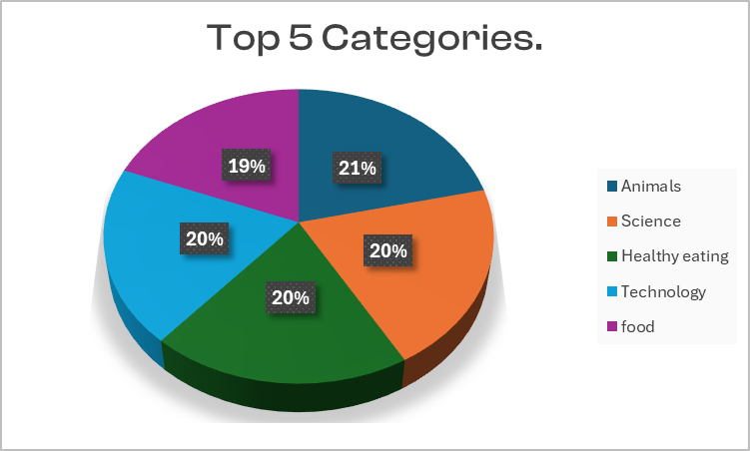

Slide 9
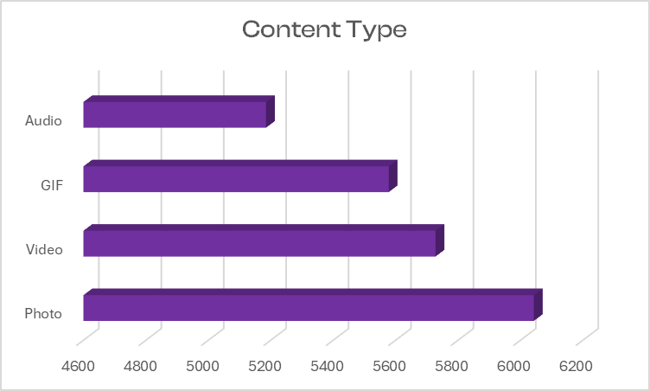

Slide 10

Animal and Science are the two most popular content categories indicating that users are interested in exploring more facts and information on these two.
Food is a common theme with the top 5 Categories with “Animal” ranking the highest. This may give an indication to the audience within your user base. You could use the insight to create a campaign and work with healthy eating brands to boots user engagement.
Social Buzz can leverage holiday seasons to boost their growth and user engagement with the food category content also.
Summary.

Slide 11
Thank you!

